Slide 1
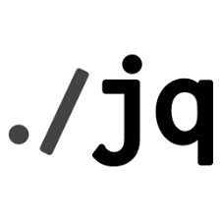

Working With JSON Arrays Using Jq Command
NarendraP
Jq Command for Bash Shell Scripting

Slide 2
Working With JSON Arrays Using Jq Command
Basics of JSON Array:
[ 1,2,4,6,8,9]
{
“technology”: “devops”,
“tools”: [
“Jenkins”,
“bamboo”,
“stackstorm”,
“git”,
“maven”
]
}
Note: JSON Array Values are called items/Elements and these are indexed (+ve and –ve)
Items/Elements are accessed using either +ve/-ve index
Accessing All Array Elements Using Iterator Filter/Array Filter: jq “.[ ]” filename
Accessing Required Array Item: jq ‘.[indexOfTheItem]’ fileName
Jq is a command-line utility to parse JSON Data

Slide 3
Thank you

